Slide 1
Graphs Definition
A graph G consists of two sets
  a finite, nonempty set of vertices V(G)
  a finite, possible empty set of edges E(G)
  G(V,E) represents a graph
An undirected graph is one in which the pair of vertices in a edge is unordered, (v0, v1) = (v1,v0)
A directed graph is one in which each edge is a directed pair of vertices, <v0, v1> != <v1,v0>
tail
head

Slide 2
Examples for Graph
0
0
0
1
2
1
2
1
3
3
4
5
6
G1
2
G2
complete graph
incomplete graph
G3
V(G1)={0,1,2,3} E(G1)={(0,1),(0,2),(0,3),(1,2),(1,3),(2,3)}
V(G2)={0,1,2,3,4,5,6} E(G2)={(0,1),(0,2),(1,3),(1,4),(2,5),(2,6)}
V(G3)={0,1,2} E(G3)={<0,1>,<1,0>,<1,2>}
complete undirected graph: n(n-1)/2 edges
complete directed graph: n(n-1) edges

Slide 3
Complete Graph
A complete graph is a graph that has the
maximum number of edges
  for undirected graph with n vertices, the maximum number of edges is n(n-1)/2
  for directed graph with n vertices, the maximum
  number of edges is n(n-1)
  example: G1 is a complete graph

Slide 4
Adjacent and Incident
If (v0, v1) is an edge in an undirected graph,
  v0 and v1 are adjacent
  The edge (v0, v1) is incident on vertices v0 and v1
If <v0, v1> is an edge in a directed graph
  v0 is adjacent to v1, and v1 is adjacent from v0
  The edge <v0, v1> is incident on v0 and v1

Slide 5
0
0
2
1
3
1
2
self edge
multigraph:
multiple occurrences
of the same edge
(a)
(b)

Slide 6
Subgraph and Path
A subgraph of G is a graph G’ such that V(G’)
is a subset of V(G) and E(G’) is a subset of E(G)
A path from vertex vp to vertex vq in a graph G,
is a sequence of vertices, vp, vi1, vi2, ..., vin, vq,
such that (vp, vi1), (vi1, vi2), ..., (vin, vq) are edges
in an undirected graph
The length of a path is the number of edges on it

Slide 7
0
0
0
1
2
0
1
2
1
2
3
1
2
3
3
G1
(i) (ii) (iii) (iv)
(a) Some of the subgraph of G₁
0
0
0
0
0
單一
1
1
1
1
分開
2
2
(i) (ii) (iii) (iv)
(b) Some of the subgraph of G₃
2
G3

Slide 8
Cycle
A cycle is a simple path in which the first and
the last vertices are the same
In an undirected graph G, two vertices, v0 and v1, are connected if there is a path in G from v0 to v1
An undirected graph is connected if, for every
pair of distinct vertices vi, vj, there is a path
from vi to vj

Slide 9
connected
0
0
1
2
1
2
3
3
4
5
6
G1
G2
tree (acyclic graph)

Slide 10
Connected Component
A tree is a graph that is connected and acyclic.
A directed graph is strongly connected if there
is a directed path from vi to vj and also
from vj to vi.

Slide 11
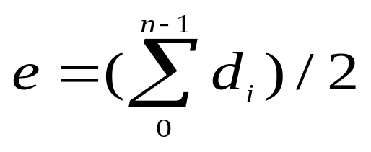
Degree
The degree of a vertex is the number of edges incident to that vertex
For directed graph,
  the in-degree of a vertex v is the number of edges
  that have v as the head
  the out-degree of a vertex v is the number of edges
  that have v as the tail
  if di is the degree of a vertex i in a graph G with n vertices and e edges, the number of edges is

Slide 12
undirected graph
degree
3
0
0
2
1
2
3
1
2
3
3
3
3
4
5
6
3
3
1
G1
1
G2
1
1
0
in:1, out: 1
directed graph
in-degree
out-degree
1
in: 1, out: 2
2
in: 1, out: 0
G3

Slide 13
Graph Representations
Adjacency Matrix
Adjacency Lists

Slide 14
Adjacency Matrix
Let G=(V,E) be a graph with n vertices.
The adjacency matrix of G is a two-dimensional
n by n array, say adj_mat
If the edge (vi, vj) is in E(G), adj_mat[i][j]=1
If there is no such edge in E(G), adj_mat[i][j]=0
The adjacency matrix for an undirected graph is symmetric; the adjacency matrix for a digraph
need not be symmetric

Slide 15
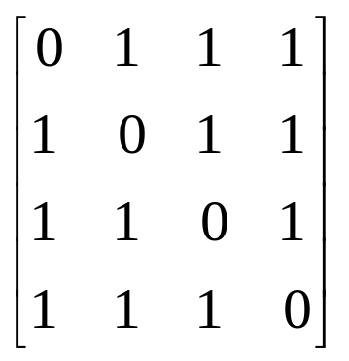
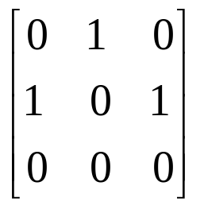
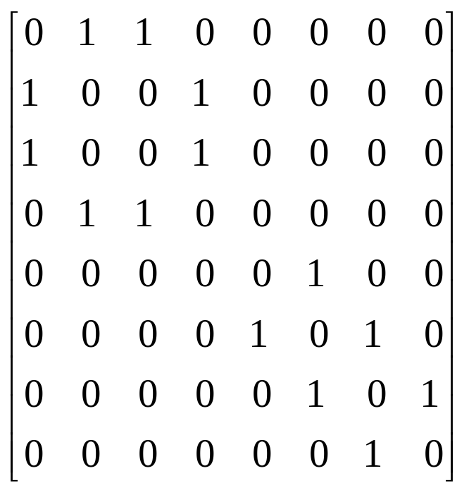
Examples for Adjacency Matrix
0
0
4
0
2
1
5
1
2
3
6
3
1
7
2
G2
G1
symmetric
undirected: n²/2
directed: n²
G4

Slide 16
0
0
4
2
1
5
1
2
3
6
3
7
0
1
2
3
1
2
3
0
1
2
3
4
5
6
7
1
2
0
2
3
0
3
0
1
3
0
3
0
1
2
1
2
G1
0
5
4
6
0
1
2
1
5
7
0
2
1
6
G3
G4
2
An undirected graph with n vertices and e edges ==> n head nodes and 2e list nodes

